Slide 1
Reactive forms
Hari Katakam
UI Lead
COLT, Corporate technology

Slide 2
What are forms
form Collection of user inputs and usually will be sent to Server
A job Application
A login page
Adding a Product in a E-commerce Site

Slide 3
Key Concepts
Elements
Text Boxes
Text Areas
Drop down options
Radio Buttons
Check boxes
Custom elements
Validation
Min and Max
Pattern
.. etc

Slide 4
Forms in Angular
Template driven forms
Template Driven Forms we specify behaviors/validations using directives and attributes in our template
All things happen in Templates
Reactive forms
Reactive forms are forms where we define the structure of the form and validation in the component class
Then, we bind it to the HTML form in the template.

Slide 5
Basic Building blocks
Form group
The FormGroup is a collection of FormControl. It can also contain other FormGroup’s.
Form Control
The FormControl is the basic building block of the Angular Forms. It represents a single input field in an Angular form.
Validators
In built/ Custom

Slide 6
Working with Template driven forms
Import Forms Module
Import { FormsModule } from '@angular/forms';
imports: [
…..
FormsModule
],
<form #contactForm="ngForm“ ….
Creates a top-level FormGroup instance
We have access to the ngForm instance via the local template variable
<input type="text" name="firstname" ngModel>
ngModel will use the name attribute to create the FormControl instance for each of the Form field it is attached.

Slide 7
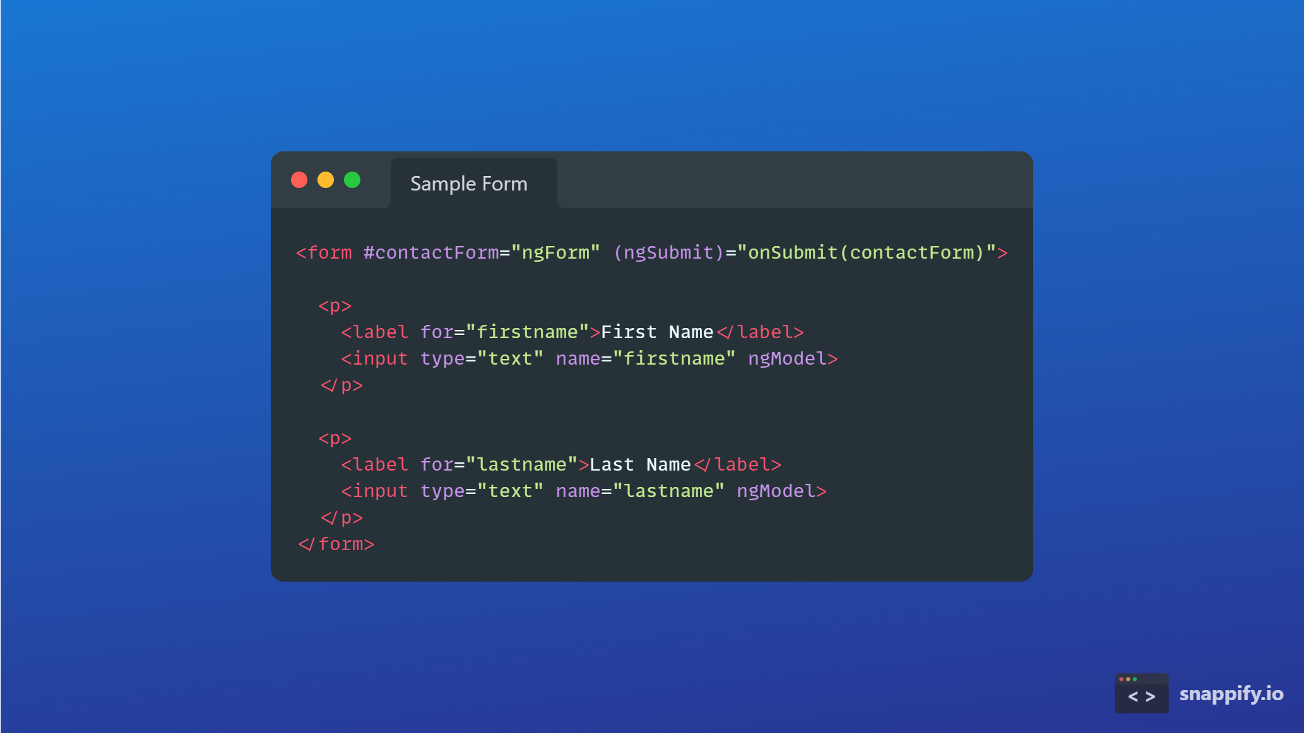
<form #contactForm="ngForm" (ngSubmit)="onSubmit(contactForm)">
<p>
<label for="firstname">First Name</label>
<input type="text" name="firstname" ngModel>
</p>
<p>
<label for="lastname">Last Name</label>
<input type="text" name="lastname" ngModel>
</p>

Slide 8
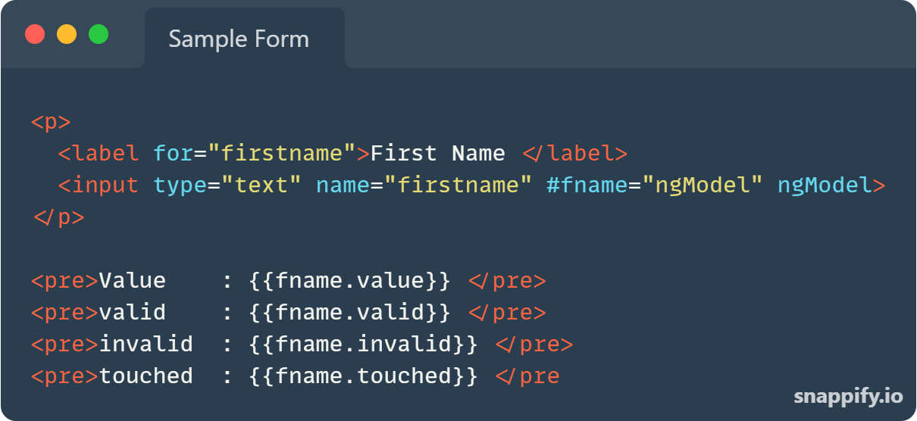

Slide 9
Working with Reactive forms
Import Forms Module
import { ReactiveFormsModule } from '@angular/forms';imports: [
…..
ReactiveFormsModule
],
FormGroup
represents a collection of form Controls
FormControl
Encapsulates the state of a single form element in our form

